Slide 1
Unlocking the Benefits of Database DevOps and Automation
Kellyn Gorman
Multiplatform Advocate and Engineer
Redgate

Slide 2




About me
Kellyn Gorman
Engineer and Advocate
Kellyn.Gorman@red-gate.com
https://linkedin.com/in/kellyngorman
https://dbakevlar.com

Slide 3

Agenda
Why Database DevOps Matters
Database DevOps Tools
Stepping Through an Example Deployment
Scripting Example
Recommended Practices
Summary

Slide 4

Why Database DevOps Matters

Slide 5
DevOps for data matters because it brings the same principles of automation, collaboration, and continuous integration/continuous delivery (CI/CD) that have transformed application development to the world of databases and data management.

Slide 6
Ensures Data Integrity and Security
Traditional database changes are often manual, increasing the risk of human errors.
DevOps practices enforce version control, automated testing, and validation before deploying schema changes.
Helps maintain compliance with regulatory standards (GDPR, HIPAA, etc.).

Slide 7
Accelerates Development and Deployment
Automating database migrations allows development teams to release new features faster without waiting for manual DB updates.
Reduces bottlenecks in database change approval processes.

Slide 8
Minimizes Downtimes and Failures
Infrastructure-as-Code (IaC) and automated rollback mechanisms ensure stability.
Introduces Data-as-Code(DaC), which is a concept around baselining data before a release, ensuring not just code changes are recoverable, but data consistency as well.
Database migrations are tested in lower environments before reaching production, reducing failed deployments.

Slide 9
Enhances Collaboration
Between Developers and DBAs
Encourages shared responsibility for database changes rather than treating DBAs as gatekeepers, which we’ve been viewed as for decades.
Version-controlled migrations in repositories (e.g., Flyway, Liquibase) provide transparency.

Slide 10
Improves Data Quality and Analytics
With automated testing and monitoring, data consistency across environments is enforced.
Ensures analytics and reporting teams work with the most up-to-date and accurate data.

Slide 11
Enables Scalability
For Cloud and Hybrid Environments
1
Cloud-native databases require rapid provisioning, replication, and backup automation.
2
DevOps practices ensure databases scale dynamically to meet demand.
3

Slide 12
By treating data as part of the DevOps lifecycle, organizations gain speed, reliability, and compliance while reducing risk

Slide 13
Database Devops Tools

Slide 14
Database Version Control and Schema Management
Flyway – Version control for database migrations, supports multiple databases.
Liquibase – Schema change automation with rollback support.
Delphix – To mask and subset data to non-prod environments.

Slide 15

CI/CD Pipelines for Databases
GitHub Actions / GitLab CI/CD – Automates database migrations alongside application code.
Azure DevOps – Integrates with SQL Server, PostgreSQL, and other databases.
Jenkins – Automates database deployment and rollback tasks.

Slide 16
Infrastructure as Code(IaC)
Terraform – Manages database infrastructure across cloud environments.
Ansible – Automates database provisioning and configuration.
Pulumi – Defines database infrastructure using modern programming languages.

Slide 17
Data-as-code
With Oracle, Datapump, Flashback and the database Recycle Bin feature offer the ability to baseline data, recover from failures and even recover individual objects with data intact.
Azure Data Factory, Golden Gate and other products allow data baseline files that can be checked into repositories, just as easy as code.
Storage snapshots offer small and simple snapshots in time of data to use for rollback purposes.

Slide 18
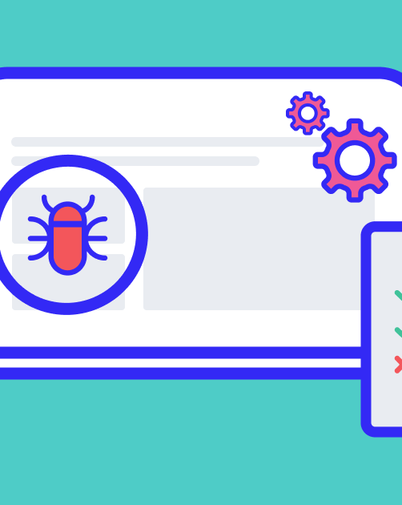
Database Testing and Validation
pgTAP (PostgreSQL) – Unit testing framework for database objects.
tSQLt (SQL Server) – Test framework for stored procedures and views.
DbFit – Database integration testing within CI/CD pipelines.

Slide 19
Performance Monitoring and Observability
Prometheus + Grafana – Real-time database monitoring and alerting.
New Relic – Monitors query performance, slow-running transactions.
Datadog – Tracks database health and resource utilization.
Redgate Monitor – Multiplatform health and resource utilization

Slide 20

Stepping through An Example Deployment

Slide 21

Story of a Deployment
A single pane of glass orchestrator
Identifying the changes to be performed.
Setup of the environment, including configurations and prechecks
Deployment of changes, logging as steps are performed.
“Error scaling” to exit in case of critical errors and undo scripts presented.
If no errors, success criteria and log releases.
Changes documented and drift cleared.

Slide 22
Scripting Example

Slide 23

Standard Data DevOps
In our DevOps example, we’ll:
Assume that our orchestrator, Flyway is already installed.
Use a Powershell script to perform the deployment
Have numerous secondary SQL scripts to execute.
Check for errors
Issues a success or failure post the deployment.

Slide 24
Set up our Project
Step 1:

Slide 25
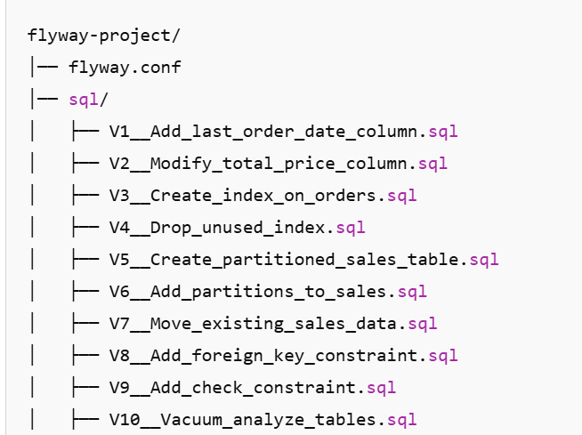
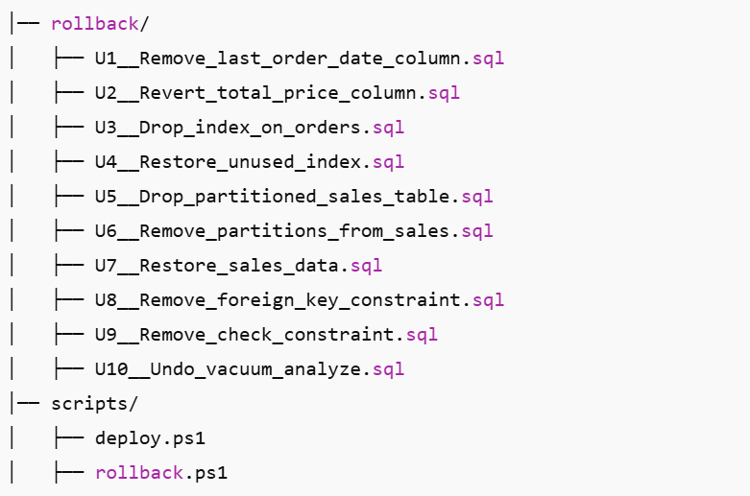
Using Flyway as the Orchestrator
Flyway Project Folders

Slide 26
Baseline Data
Step 2:

Slide 27
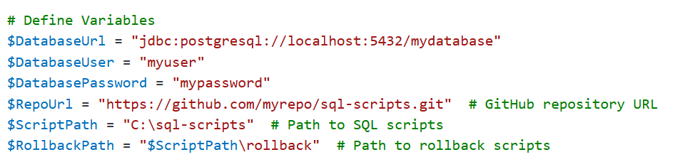
Powershell- Define Variables

Slide 28
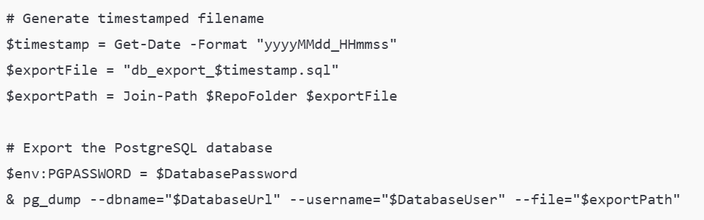
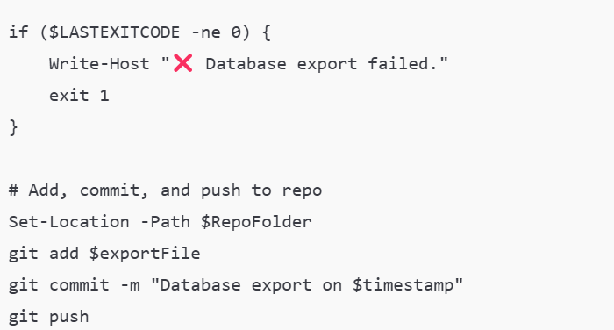
Export Baseline Data Script

Slide 29
Script Changes
Step 3:

Slide 30
Powershell- Define Variables

Slide 31
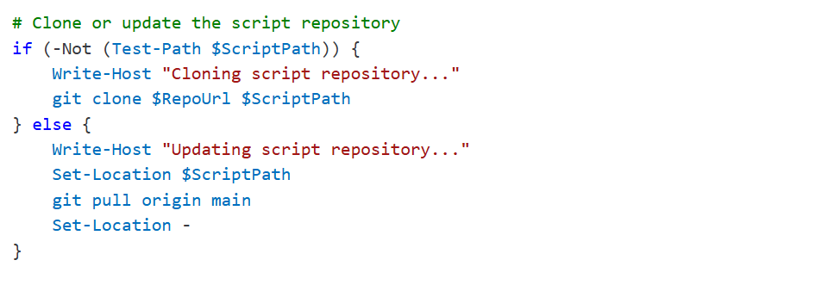
Clone the Repository

Slide 32
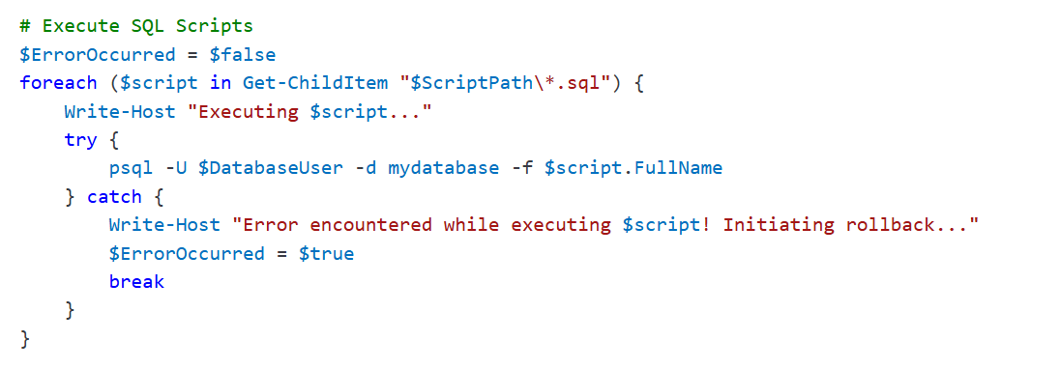
Execute All SQL Scripts

Slide 33
Actual Database Changes
Step 3:

Slide 34
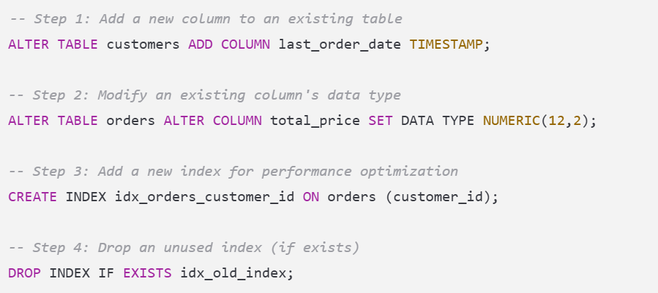
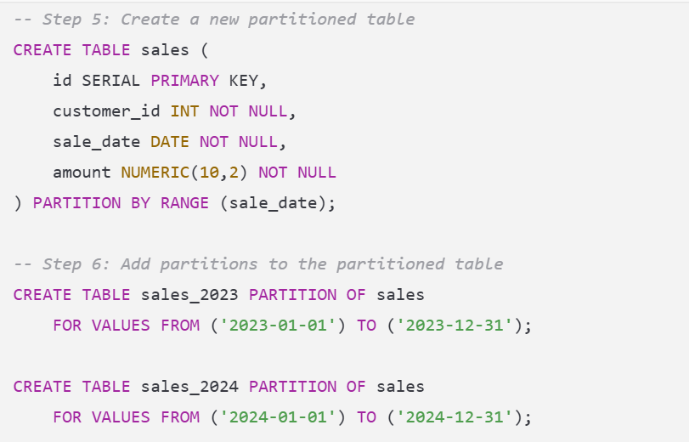
SQL Script

Slide 35
Final Changes and optimize from changes
-- Step 7: Move existing data into partitions (if applicable)
INSERT INTO sales_2023 SELECT * FROM sales WHERE sale_date BETWEEN '2023-01-01' AND '2023-12-31';
INSERT INTO sales_2024 SELECT * FROM sales WHERE sale_date BETWEEN '2024-01-01' AND '2024-12-31';
-- Step 8: Add a foreign key constraint
ALTER TABLE orders ADD CONSTRAINT fk_orders_customers FOREIGN KEY (customer_id) REFERENCES customers(id);
-- Step 9: Add a check constraint
ALTER TABLE customers ADD CONSTRAINT chk_valid_age CHECK (age >= 18);
-- Step 10: Perform vacuum analyze for performance optimization
VACUUM ANALYZE customers;
VACUUM ANALYZE orders;
VACUUM ANALYZE sales;

Slide 36
Undo Changes
Step 4:

Slide 37
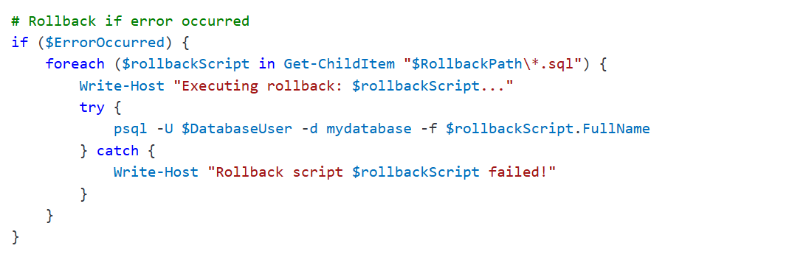
Rollback if Errors

Slide 38
But if All Goes Well
Step 5:

Slide 39

Success!

Slide 40
Devops When Orchestrator Includes Database
Impact factor | Manual | With Database DevOps Tools (Commonly)
Versioning | Often Separate | Included
Rollback Control | Must be Generated Manually | Included
Logging | If in scripts or added manually | Part of deployment and verbose option
History | Minimal unless audited | Impressive history in Source Control
Tool Usage | Different tooling dependent on teams | Single Tooling

Slide 41
Recommended Practices

Slide 42
Treat Database Changes like Code
Store all schema changes in version control (Git).
Baseline data BEFORE release via export, snapshot or data copy, (choose base off performance/size)
Use branching strategies (e.g., GitFlow) for database migrations.
Apply database changes via automated CI/CD pipelines.

Slide 43
Automate Database Migrations
Use enterprise change release tools to manage schema changes.
Run migrations in lower environments first (Dev → Test → Prod).
Automate rollback scripts and data restoration for failed deployments.

Slide 44
Implement CI/CD testing Routines
Write unit tests for stored procedures and views.
Validate data integrity before and after schema changes, even if you’re only doing so on a subset of full dataset.
Perform load and performance testing before pushing to production.

Slide 45
Use Feature Flags for Changes
Deploy schema changes without enabling them immediately.
Enable new database features incrementally via feature toggles.

Slide 46
Monitor and Optimize Performance Regularly
Automate
Automate indexing and partitioning strategies based on query performance.
Query
Collect query execution metrics to optimize slow queries.
Implement
Implement database anomaly detection using monitoring tools.

Slide 47
Secure Data and Ensure Compliance
Automate database access control (e.g., Role-Based Access Control).
Mask or encrypt sensitive data in non-prod environments.
Integrate audit logging for all database changes.

Slide 48

By Following…
these best practices and leveraging the right tools, teams can reduce risk, accelerate development, and improve database reliability in a DevOps-driven environment.

Slide 49

Thank you
Kellyn Gorman
Multiplatform Advocate and Engineer
Redgate
Kellyn.Gorman@red-gate.com
https://linkedin.com/in/kellyngorman
https://dbakevlar.com

Slide 50
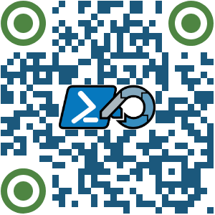
THANK YOU
Feedback is a gift. Please review this session

